Slide 1

7th Grade Math
Unit 3, Lesson 7 Solving Real-World Problems with Rational Numbers – Part 3 Volume 1, pg. 113

Slide 2


Benchmark
MA.7.NSO.2.3
Solve real-world problems involving any of the four operations with rational numbers.
volume 1, pg. 113

Slide 3
Integrated Mathematical Thinking and Reasoning Standards
MA.K12.MTR.1.1 Actively participate in effortful learning both individually and collectively.
MA.K12.MTR.3.1 Complete tasks with mathematical fluency.
MA.K12.MTR.4.1 Engage in discussions that reflect on the mathematical thinking of self and others.
MA.K12.MTR.5.1 Use patterns and structure to help understand and connect mathematical concepts.
MA.K12.MTR.7.1 Apply mathematics to real-world contexts.
volume 1, pg. 113

Slide 4

Learning Target
I can solve problems with three operations involving any of the four operations with rational numbers.
volume 1, pg. 113

Slide 5

Warm-Up
volume 1, pg. 114

Slide 6
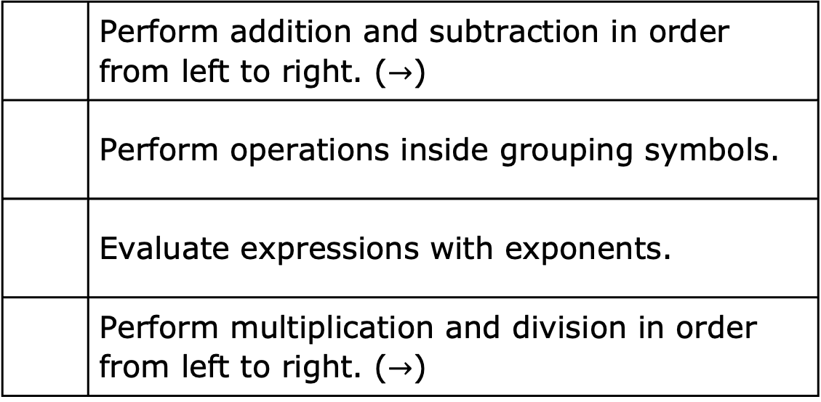
3.7.1 Warm-Up: Bell Work
Number each operation using numbers 1-4 to reflect the correct order of the order of operations.
 | Perform addition and subtraction in order from left to right. ($→$)
 | Perform operations inside grouping symbols.
 | Evaluate expressions with exponents.
 | Perform multiplication and division in order from left to right. ($→$)
volume 1, pg. 114
Notes:
Video Link: https://algebranation.wistia.com/medias/fi4fidi5y8

Slide 7

Activity
volume 1, pg. 114

Slide 8

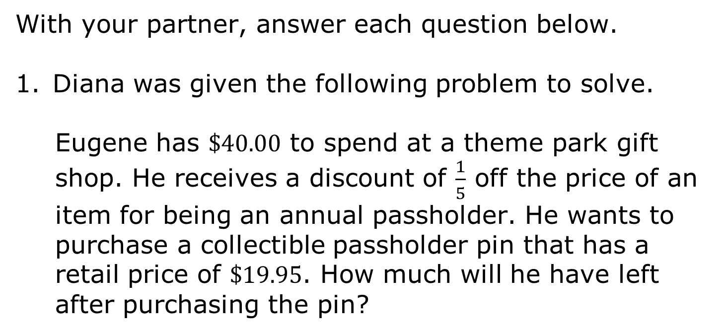
3.7.2 Activity: Error Analysis
With your partner, answer each question below.
Diana was given the following problem to solve.
Eugene has $\$40.00$ to spend at a theme park gift shop. He receives a discount of $\frac{1}{5}$ off the price of an item for being an annual passholder. He wants to purchase a collectible passholder pin that has a retail price of $\$19.95$. How much will he have left after purchasing the pin?
volume 1, pg. 114

Slide 9
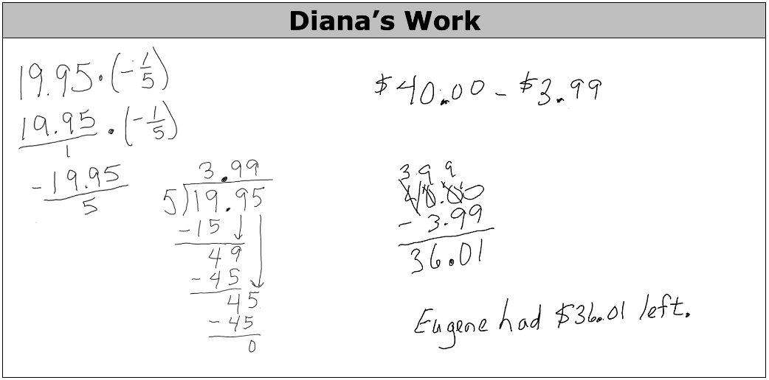
Diana solved the problem with the steps shown.
Identify what Diana did correctly and incorrectly.
Correct | Incorrect
volume 1, pg. 114

Slide 10
How much money will Eugene have left over after buying the pin? Show your work.
volume 1, pg. 115

Slide 11
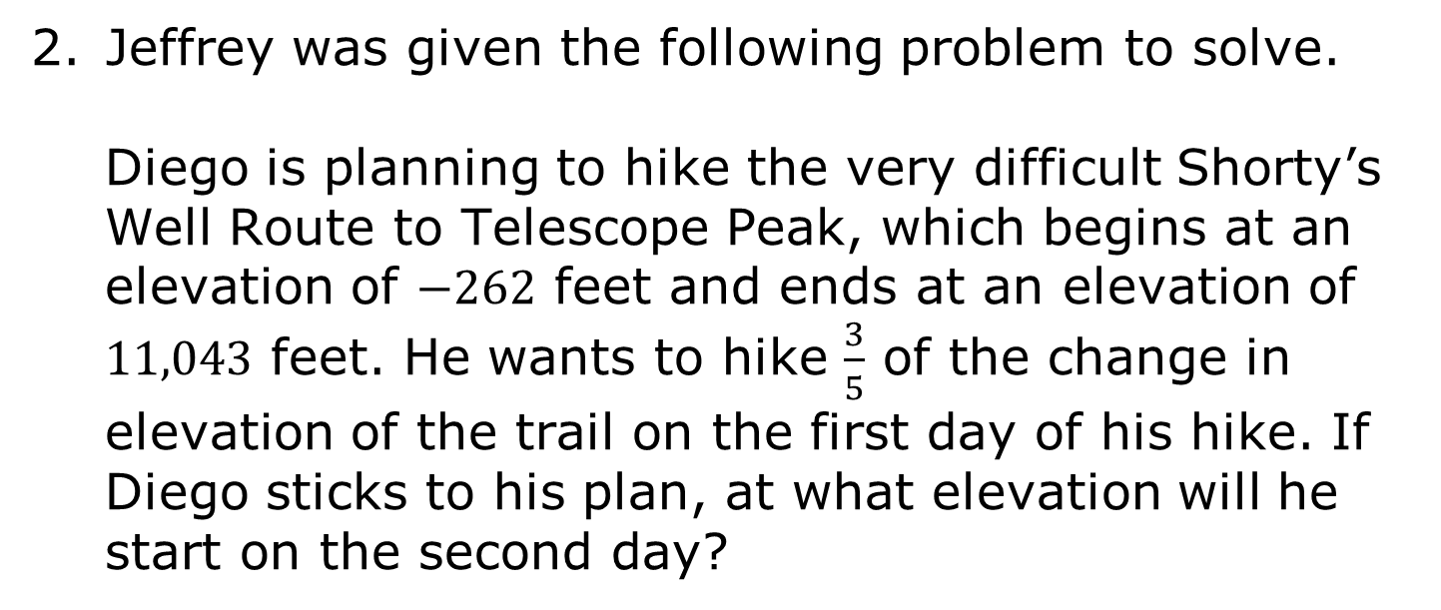
Jeffrey was given the following problem to solve.
Diego is planning to hike the very difficult Shorty’s Well Route to Telescope Peak, which begins at an elevation of $−262$ feet and ends at an elevation of $11,043$ feet. He wants to hike $\frac{3}{5}$ of the change in elevation of the trail on the first day of his hike. If Diego sticks to his plan, at what elevation will he start on the second day?
volume 1, pg. 115

Slide 12
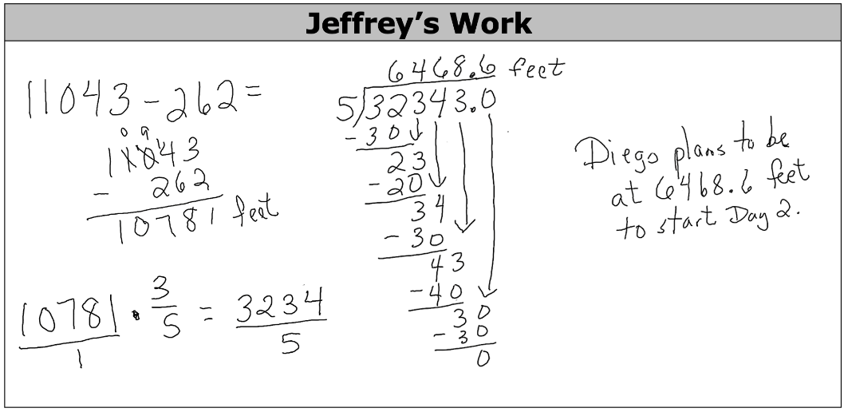
Jeffrey solved the problem with the steps shown.
Identify what Jeffrey did correctly and incorrectly.
Correct | Incorrect
volume 1, pg. 115

Slide 13
At what elevation will Diego start on the second day? Show your work.
volume 1, pg. 115

Slide 14
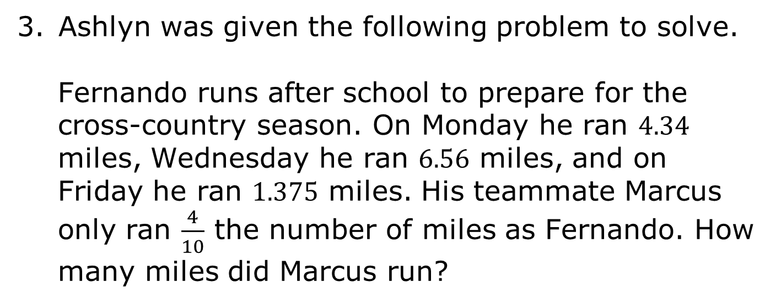
Ashlyn was given the following problem to solve.
Fernando runs after school to prepare for the cross-country season. On Monday he ran $4.34$ miles, Wednesday he ran $6.56$ miles, and on Friday he ran $1.375$ miles. His teammate Marcus only ran $\frac{4}{10}$ the number of miles as Fernando. How many miles did Marcus run?
volume 1, pg. 116

Slide 15
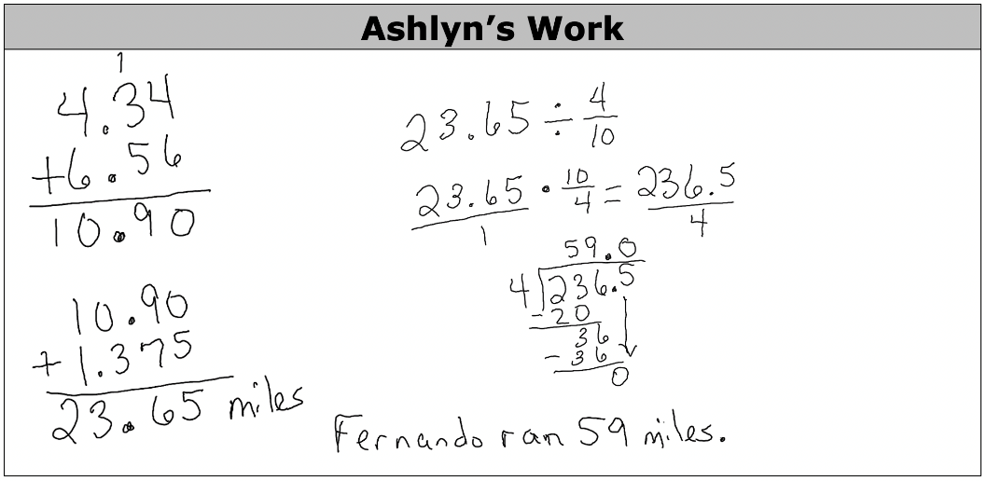
Ashlyn solved the problem with the steps shown.
Identify what Ashlyn did correctly and incorrectly.
Correct | Incorrect
volume 1, pg. 116

Slide 16
How many miles did Marcus run? Show your work.
volume 1, pg. 116

Slide 17
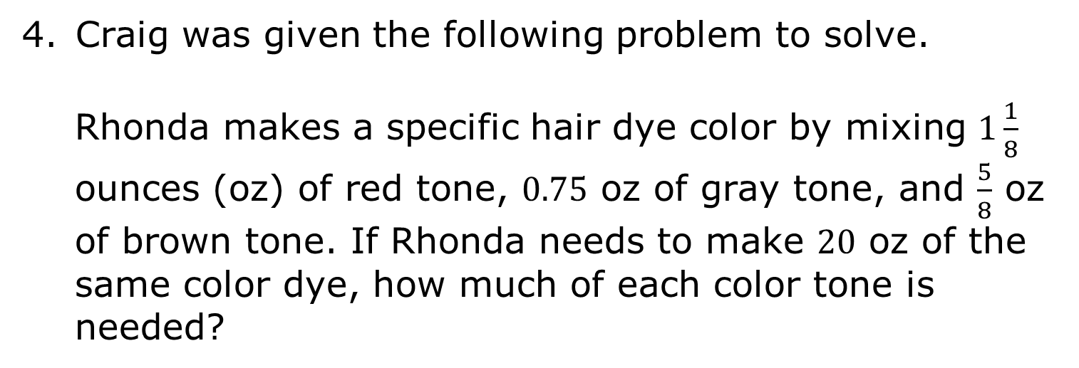
Craig was given the following problem to solve.
Rhonda makes a specific hair dye color by mixing $1\frac{1}{8}$ ounces (oz) of red tone, $0.75$ oz of gray tone, and $\frac{5}{8}$ oz of brown tone. If Rhonda needs to make $20$ oz of the same color dye, how much of each color tone is needed?
volume 1, pg. 116

Slide 18
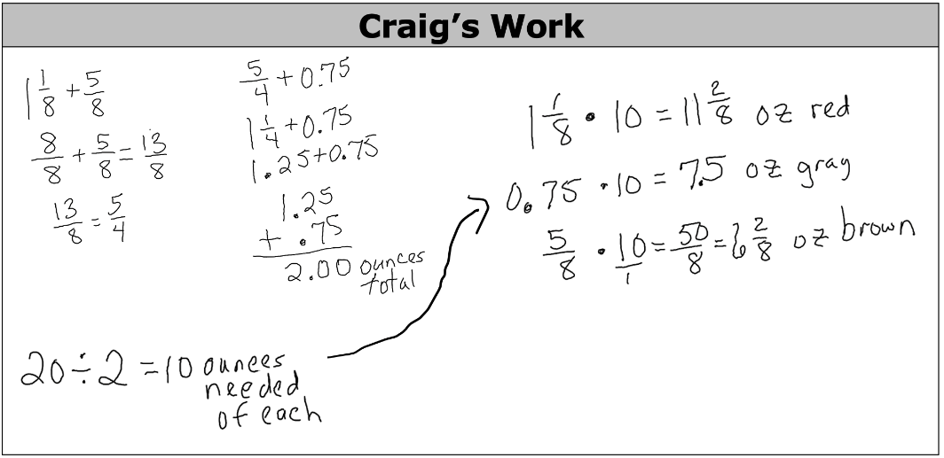
Craig solved the problem with the steps shown.
Identify what Craig did correctly and incorrectly.
Correct | Incorrect
volume 1, pg. 116

Slide 19
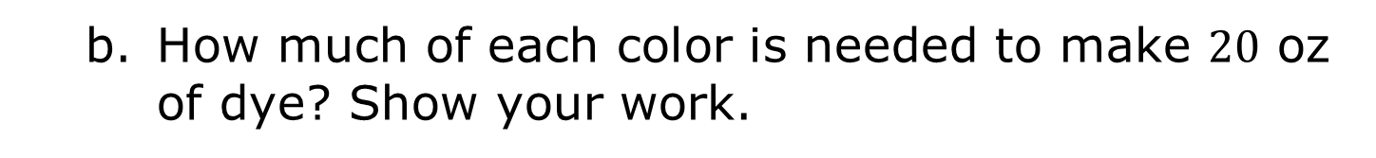
How much of each color is needed to make $20$ oz of dye? Show your work.
volume 1, pg. 117

Slide 20

Collaboration
volume 1, pg. 117

Slide 21

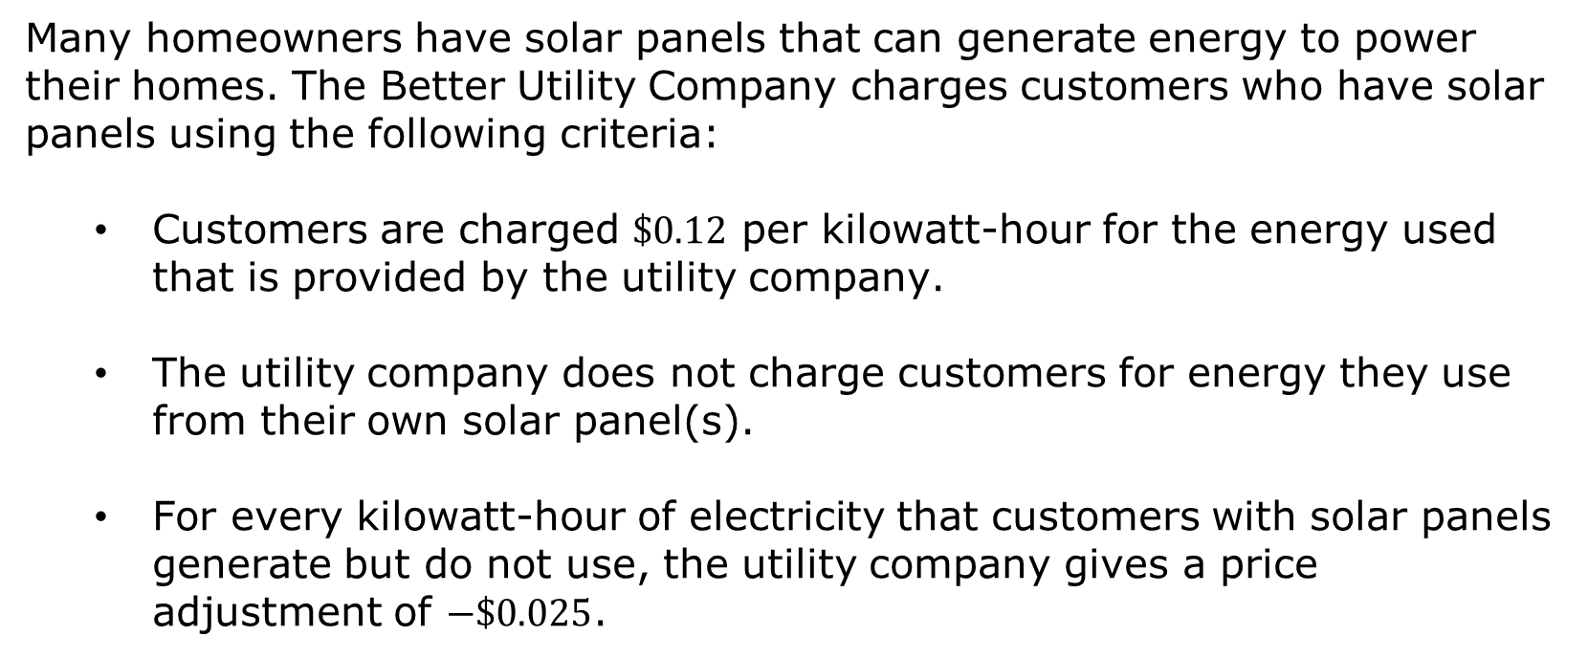
3.7.3 Collaboration: Finding Missing Values
Many homeowners have solar panels that can generate energy to power their homes. The Better Utility Company charges customers who have solar panels using the following criteria:
Customers are charged $\$0.12$ per kilowatt-hour for the energy used that is provided by the utility company.
The utility company does not charge customers for energy they use from their own solar panel(s).
For every kilowatt-hour of electricity that customers with solar panels generate but do not use, the utility company gives a price adjustment of $−\$0.025$.
volume 1, pg. 117

Slide 22
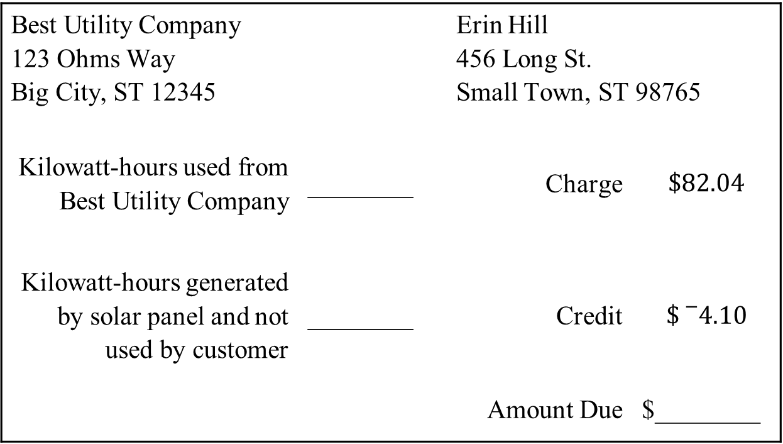
Erin Hill’s bill for the month of July is missing some information.
Best Utility Company 123 Ohms Way Big City, ST 12345 |  | Erin Hill 456 Long St. Small Town, ST 98765
Kilowatt-hours used from Best Utility Company | ________ | Charge | $$\$82.04$$
Kilowatt-hours generated by solar panel and not used by customer | ________ | Credit | $$\${}_{}^{−}{4.10}$$
 |  | Amount Due | $________
volume 1, pg. 117

Slide 23
Work with your partner to fill in the missing information on the bill. Round answers to nearest hundredth.
Find another classmate other than your partner and compare your missing values.
If the missing values for both are the same, have your classmate initial next to each value in your bill.
If the missing values are different, discuss your work to determine what error(s) were made. After correcting any mistakes, initial next to each value in each other’s bill.
volume 1, pg. 118

Slide 24

Wrap-Up
volume 1, pg. 118

Slide 25
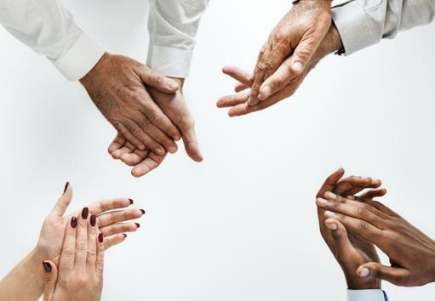
3.7.4 Wrap-Up: Reflection
Complete the table by reflecting on the day’s lesson.
Today I deserve for …
volume 1, pg. 118

Slide 26
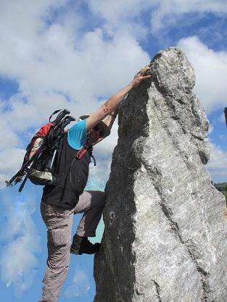
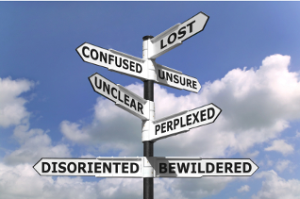
Today I by doing …
Today I was by …
volume 1, pg. 118

